Slide 1

Create a Facebook or Instagram Business Account

Slide 2



How to Insert an Image
Make a copy or download this template to use on your own device.
We’ve provided a video below that shows how to add and edit an image in Google slides.
Select either the Facebook business page (slide 3) or Instagram account template (slide 4) and complete all required components for project submission.
Take a screenshot of your completed template and submit it on Coursera. You can find the link to submit here
Create a Facebook or Instagram Business Account
01

Slide 3
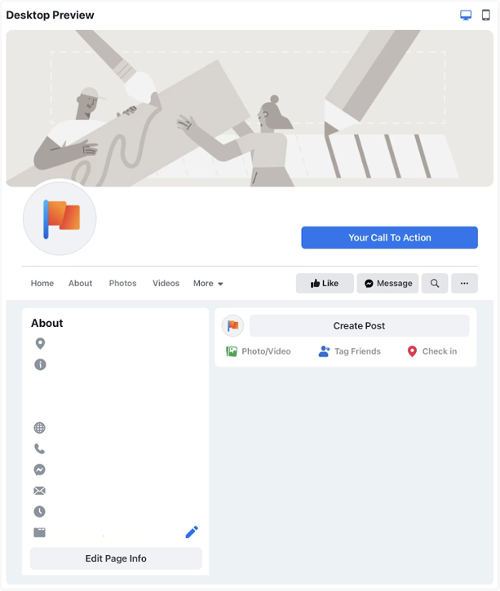
Page Name
Category
Enter Location
Description
Enter Website
Enter phone number
Enter message
Enter email
Enter business hours
Food Delivery Service
Create a Facebook or Instagram Business Account
02

Slide 4
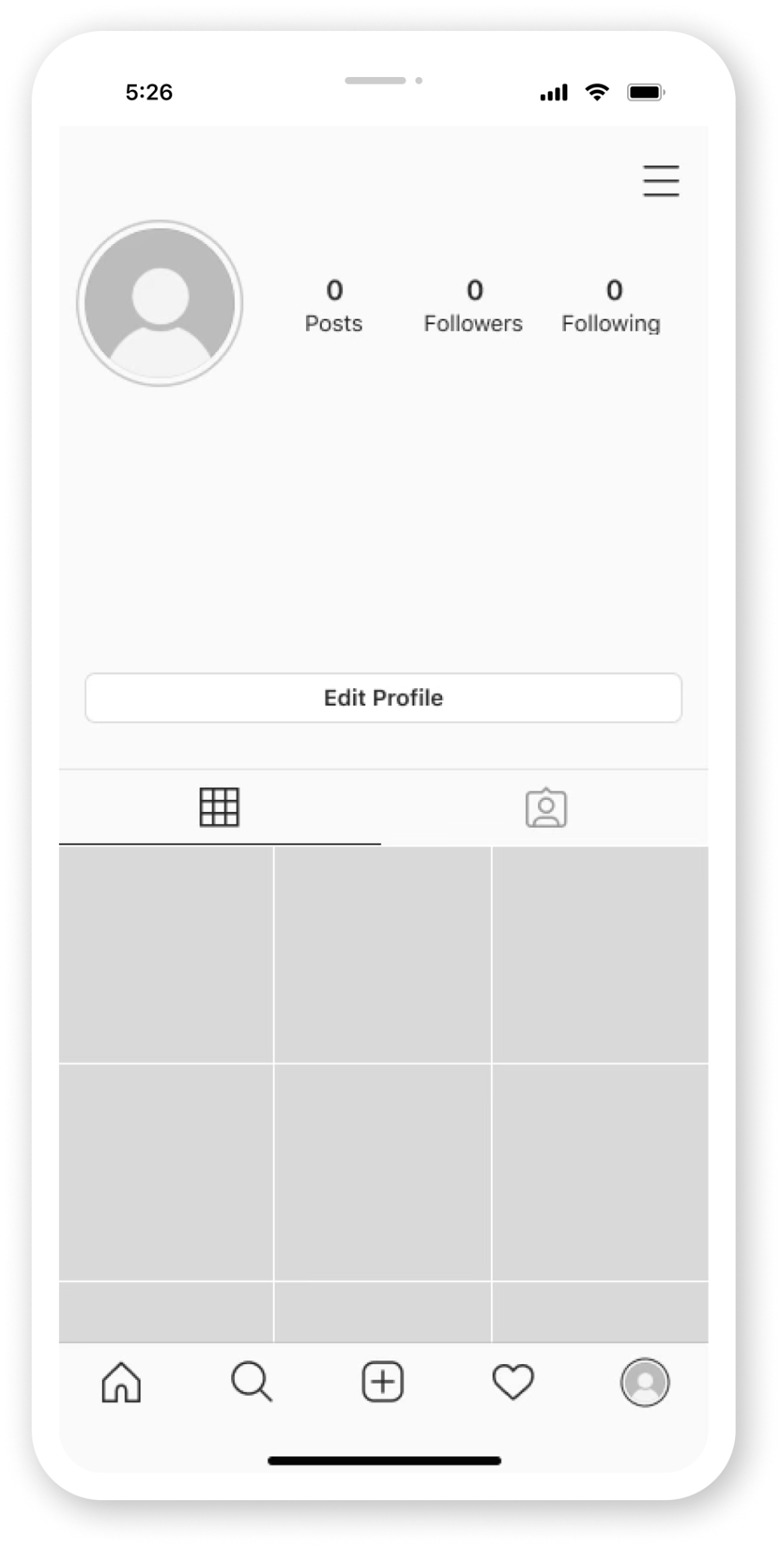
your_company_name
Your Company Name
Business Category
Your Business Description (150 characters)
www.yourwebsite.com
Your Location
Your First Post (Your business
Image)
Create a Facebook or Instagram Business Account
03

